Slide 1


PARK IT
Don't circle, just Park It.
BY TEAM : OKAY

Slide 2




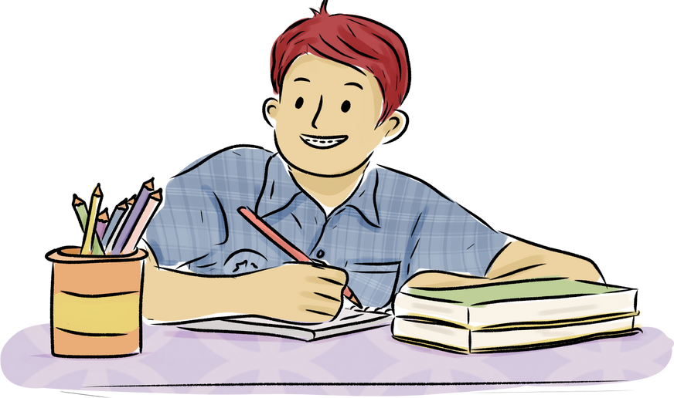


Hey, there!
YANA
We're Team CODE CRAFTERS the developers of “PARK EASY”. A one end-to-end Parking Management
ANSH
DIVYANSH

Slide 3


Why ???
Parking Congestion:
- Limited spaces, high demand
- Scarcity of spots causes frustration
Traffic Disruptions:
- Inadequate parking contributes to congestion
- Increased pollution due to circling cars
Frustrations for Drivers:
- Difficulty finding convenient and affordable spots
- Wasted time impacts urban mobility experience

Slide 4

The Solution....
Real-Time Availability: Check for parking in real-time, reducing search time.
Seamless Booking: Online parking slot booking for convenience and peace of mind.
Parking Congestion: Addressing limited spaces and high demand in urban areas.
Traffic Disruptions: Alleviating traffic issues and pollution caused by inadequate parking.

Slide 5

Thank you very much!
Team Code Crafters,
Divyansh 2110992203
Yana 2110992092
Ansh 2110992185

